Slide 1


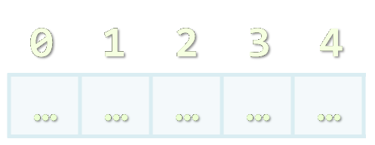

Arrays, Lists, Stacks, Queues
Processing Sequences of Elements
SoftUni Team
Technical Trainers
Software University
http://softuni.bg

Slide 2


Table of Contents
Declaring and Creating Arrays
Accessing Array Elements
Reading and Printing Arrays at the Console
Iterating over Arrays Using for and foreach
Resizable Arrays: List<T>
Other Structures: Stack<T> and Queue<T>
LINQ Extension Methods for Collections

Slide 3


Declaring and Creating Arrays

Slide 4

What are Arrays?
An array is a sequence of elements
All elements are of the same type
The order of the elements is fixed
Has fixed size (Array.Length)
Element of an array
0 1 2 3 4
Element index (position)
Array of 5 elements
… | … | … | … | …

Slide 5

Declaring Arrays
Declaration defines the type of the elements
Square brackets [] mean "array"
Examples:
Declaring array of integers:
Declaring array of strings:
int[] intArr;
string[] stringArr;

Slide 6

Creating Arrays
Use the operator new
Specify the array length (fixed number of elements)
Example: creating (allocating) array of 5 integers:
myIntArray = new int[5];
0 1 2 3 4
myIntArray
… | … | … | … | …
managed heap
(dynamic memory)

Slide 7
Creating and Initializing Arrays
Creating and initializing can be done in a single statement:
The new operator is not required when using curly brackets initialization
myIntArray = {1, 2, 3, 4, 5};
0 1 2 3 4
myIntArray
1 | 2 | 3 | 4 | 5
managed heap
(dynamic memory)

Slide 8

Creating Array – Example
Creating an array to hold the names of the days of the week
string[] daysOfWeek =
{
"Monday",
"Tuesday",
"Wednesday",
"Thursday",
"Friday",
"Saturday",
"Sunday"
};

Slide 9

Accessing Array Elements
Read and Modify Elements by Index

Slide 10
How to Access Array Element?
Array elements are accessed
Using the square brackets operator [] (indexer)
Array indexer takes element’s index as parameter
The first element has index 0
The last element has index Length-1
Elements can be retrieved and changed by the [] operator
string[] arr = new string[2];
string arr[1] = "Maria";
arr[0] = arr[1];

Slide 11
Accessing Array Elements – Examples
string[] towns = { "Sofia", "Varna", "Bourgas" };
Console.WriteLine(towns); // System.String[]
Console.WriteLine(towns.Length); // 3
Console.WriteLine(towns[0]); // Sofia
Console.WriteLine(string.Join(", ", towns)); // Sofia, Varna, Bourgas
towns[0] = "Pleven";
towns[2] = null;
Console.WriteLine(string.Join(", ", towns)); // Pleven, Varna,
Console.WriteLine(towns[3]); // IndexOutOfRangeException
towns.Length = 4; // Length is read-only

Slide 12

Accessing Elements By Index
Live Demo

Slide 13
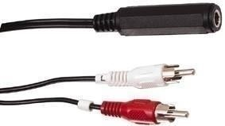
Arrays: Input and Output
Reading and Printing Arrays on the Console

Slide 14
Reading Arrays From the Console
First, read from the console the length of the array
Next, create the array of given size n and read its elements:
int n = int.Parse(Console.ReadLine());
int[] arr = new int[n];
for (int i = 0; i < n; i++)
{
arr[i] = int.Parse(Console.ReadLine());
}

Slide 15
Reading Array Values at a Single Line
We can also read all array values separated by a space
Or even write the above at a single line:
string values = Console.ReadLine();
string[] items = values.Split(' ');
int[] arr = new int[items.Length];
for (int i = 0; i < items.Length; i++)
{
arr[i] = int.Parse(items[i]);
}
int[] arr = Console.ReadLine().Split(' ')
.Select(int.Parse).ToArray();

Slide 16
Printing Arrays on the Console
Process all elements of the array
Print each element to the console
Separate elements with white space or a new line
string[] array = {"one", "two", "three"};
// Process all elements of the array
for (int index = 0; index < array.Length; index++)
{
// Print each element on a separate line
Console.WriteLine(element[{0}] = {1}",
index, array[index]);
}

Slide 17
Printing with String.Join(…) / ForEach(…)
Use string.Join(separator, collection) to print an array:
Or use the functional-style for-each:
int[] arr = { 1, 2, 3 };
Console.WriteLine(string.Join(", ", arr)); // 1, 2, 3
string[] strings = { "one", "two", "three" };
Console.WriteLine(string.Join("-", strings)); // one-two-three
int[] arr = { 1, 2, 3 };
arr.ToList().ForEach(a => Console.WriteLine(a));

Slide 18
Printing Arrays
Live Demo

Slide 19
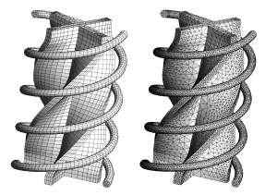
Processing Array Elements Using for and foreach

Slide 20
Processing Arrays: for Statement
Use for loop to process an array when
Need to keep track of the index
Processing is not strictly sequential from the first to the last
In the loop body use the element at the loop index (array[index]):
for (int index = 0; index < array.Length; index++)
{
squares[index] = array[index] * array[index];
}

Slide 21
Processing Arrays Using for Loop – Examples
Printing array of integers in reversed order:
Initialize array elements with their index:
int[] arr = new int[] {1, 2, 3, 4, 5};
Console.WriteLine("Reversed: ");
for (int i = array.Length - 1; i >= 0; i--)
Console.Write(array[i] + " ");
// Result: 5 4 3 2 1
for (int index = 0; index < array.Length; index++)
{
array[index] = index;
}

Slide 22

Processing Arrays: foreach
How the foreach loop works?
type – the type of the element
value – local name of a variable
collection – the collection/array to iterate
Used when no indexing is needed
All elements are accessed sequentially
Elements can not be modified (read only)
foreach (type value in collection)

Slide 23
Processing Arrays Using foreach – Example
Print all elements of a string[] array:
string[] capitals =
{
"Sofia",
"Washington",
"London",
"Paris"
};
foreach (string capital in capitals)
{
Console.WriteLine(capital);
}

Slide 24

Processing Arrays
Live Demo

Slide 25
Static Methods in the Array Class
Array.Clear(arr, index, length) – deletes all elements
Array.ConvertAll(arr, convertFunction)
Converts an array of one type to an array of another type
Array.IndexOf(arr, item)
Finds an item in array (returns the first occurrence index or -1)
Array.Reverse() – reverses the elements order
Array.Sort() – sorts an array in increasing order

Slide 26

Array Static Methods
Live Demo

Slide 27

Exercises in Class

Slide 28
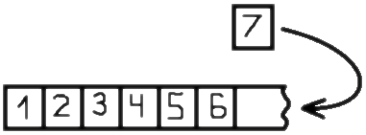

Resizable Arrays
List<T>

Slide 29
Lists (Resizable Arrays)
List<T> – array that can resize dynamically
Can add / remove / insert elements
Also provides indexed access with [] (like arrays)
T is the type for the list elements
E.g. List<int> will hold integers, List<object> will hold objects
Basic properties
Count – returns the current size of the list
Capacity – returns the current capacity of the list

Slide 30
List Example
This code:
Is like this:
The main difference
The number of elements in List<T> is variable
List<int> intList = new List<int>();
for (int i = 0; i < 5; i++)
intList.Add(i);
int[] intArray = new int[5];
for (int i = 0; i < 5; i++)
intArray[i] = i;

Slide 31


Lists <T>
Live Demo

Slide 32
How The List<T> Works?
List<T> internally keeps its items in an array – T[]
It has bigger Capacity (buffer) than the elements inside (Count)
Typically "Add" is fast → just adds an element is an empty cell
Resizing is slow, but happens rarely: log₂(n) times
Capacity
List<int>:
Count = 9
Capacity = 15
3 | -2 | 5 | 11 | 9 | -1 | 7 | 33 | 8
used buffer
(Count)
unused buffer

Slide 33


Resizing Lists
Live Demo

Slide 34
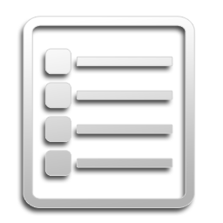
List<T> Methods
Brief Overview

Slide 35
List<T> Methods (1)
List<T>.Add(item) – adds an item to the end
List<T>.AddRange(items) – adds many items at the end
List<T>.Clear() – clears the list
List<T>.IndexOf(item) – search for item
Return the first occurrence index or -1
List<T>.Insert(item, index) – inserts an item at position
List<T>.InsertRange(items, index)
Inserts many items at specified position

Slide 36
List<T> Methods (2)
List<T>.Remove()
Removes the first occurrence of a specific item
List<T>.RemoveAt()
Removes the element at the specified index
List<T>.Reverse()
List<T>.Sort()
List<T>.ToArray()

Slide 37
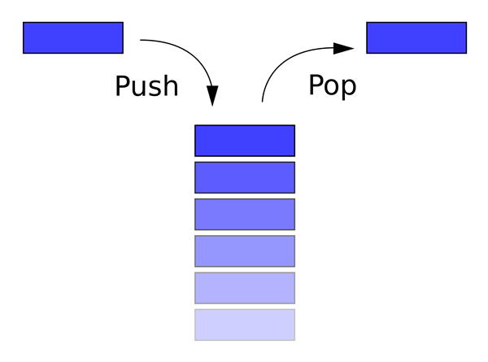
Stack – LIFO Data Structure
Stack is last-in-first-out (LIFO) collection of elements

Slide 38
Stack<T>
Stack<T> holds a stack of elements
Count – the number of elements in the Stack<T>
Peek() – check the value of the last element
Pop() – return the last element and remove it from the stack
Push() – add an element to the Stack<T>
ToArray() – converts list to array
Contains() – determines whether an element is in the stack

Slide 39

Working with Stacks
Live Demo

Slide 40
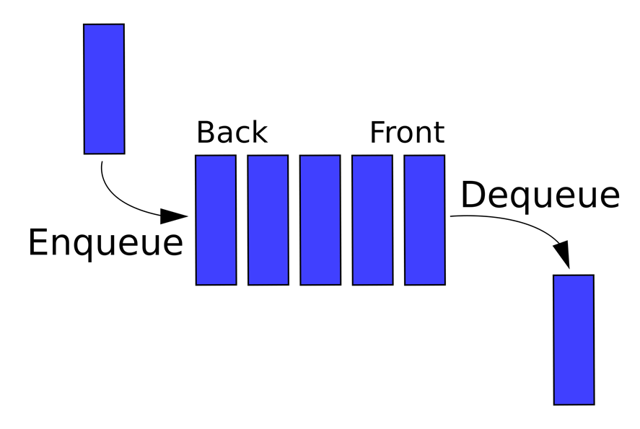
Queue – FIFO Data Structure
Queue is first-in-first-out (FIFO) collection of elements

Slide 41
Queue<T>
Queue<T> holds a queue of elements:
Enqueue() – add an element at the end of the queue
Dequeue() – remove the first element and remove it
Count – return the number of elements in the queue
Peek() – check the value of the first element
ToArray() – converts the queue to array
Contains() – checks whether an element is in the queue

Slide 42
Queue<T>
Live Demo

Slide 43

LINQ Extension Methods for Collections
Brief Overview

Slide 44
Using System.LINQ with collections
What are extension methods?
Attach functionality to existing types
How to use LINQ extension methods?
Add "using System.Linq;" at the start of your C# file
Call them as you call a regular instance method
var array = {1, 2, 3, 4, 5};
Console.WriteLine(array.Sum()); // 15
Console.WriteLine(array.Max()); // 5

Slide 45
LINQ Extension Methods
Distinct() – returns the distinct elements from a sequence
First() and FirstOrDefault()
Intersect() and Union()
Min(), Max(), Sum() and Average()
Skip() – bypasses a specified number of elements in a sequence and then returns the remaining elements
Take() – returns a specified number of contiguous elements from the start of a sequence

Slide 46
LINQ Extension Methods
Live Demo

Slide 47
Summary
Arrays are a fixed-length sequences of elements of the same type
Array elements are accessible by index (read / modify)
Iterate over array elements with for and foreach loops
List<T> holds resizable arrays
Good when we don't know the number of elements initially
Stack<T> and Queue<T> provides LIFO and FIFO lists
LINQ extension methods attach additional functionality for collection processing

Slide 48
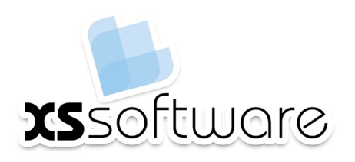








Arrays, Lists, Stacks, Queues
https://softuni.bg/courses/advanced-csharp

Slide 49
License
This course (slides, examples, demos, videos, homework, etc.) is licensed under the "Creative Commons Attribution-NonCommercial-ShareAlike 4.0 International" license
Attribution: this work may contain portions from
"Fundamentals of Computer Programming with C#" book by Svetlin Nakov & Co. under CC-BY-SA license
"C# Part I" course by Telerik Academy under CC-BY-NC-SA license
"C# Part II" course by Telerik Academy under CC-BY-NC-SA license

Slide 50





Free Trainings @ Software University
Software University Foundation – softuni.org
Software University – High-Quality Education, Profession and Job for Software Developers
softuni.bg
Software University @ Facebook
facebook.com/SoftwareUniversity
Software University @ YouTube
youtube.com/SoftwareUniversity
Software University Forums – forum.softuni.bg

